Slide 1
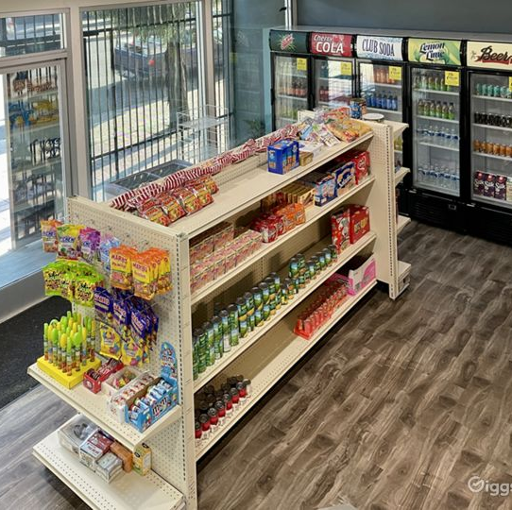
What is a Consumer Co-op

Slide 2
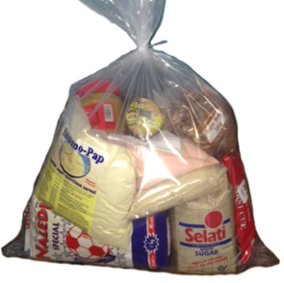
What is Consumer Co-operative
A consumer co-operative is a type of co-operative is owned and controlled by consumers, who come together to prioritise their common needs and interests, rather than maximizing profits. Consumer co-operative supports local producers and businesses, thereby contributing to local employment and community self reliance.
One of the main goals of a consumer co-operative is to provide good food and non-food items at fair prices.
By owning and controlling their co-operatives, members organise their collective purchasing power and negotiate favourable prices with suppliers, eliminate middle man resulting in cost savings. These savings are passed to members in at fair priced products.

Slide 3
Distinguishing features | Consumer Co-operative | Spaza Shop | Big Retail Stores
Ownership | Consumers collectively own the business (e.g Community owned stores, bakeries, or warehouses). Membership share is required as a condition of membership | Individuals or family own the shop | Shareholders, investors own the store based on capital. In other words, It is capital or money that owns the business not members.
Control | Democratically controlled by its members who elect board of directors from membership. Decision making based on ‘one member one vote, or consensus not number of shares a member hold in a co-operative. Members have a say in decision making process. These includes decisions resulting to pricing policies, product selection and overall operations. By involving members in this decisions, the co-op can ensure that the pricing of products is in line with the needs and preferences of the members. | Decisions are made by individuals or family members Consumer do not participate in decision making e.g pricing of products or product selection | Decision making is based on number of shares each investor holds –’one share, one vote, two share, two votes…” Consumer do not participate in decision making e.g pricing of products or product selection
Profit or Surplus Distribution | Unlike traditional for profit business, consumer co-operate operate on a not-for-profit basis, which allows them to focus on providing affordable products rather than generating excessive profits. -Members have equal shares in a co-operative regardless of the amount of shares invested by a member | Profits are distributed among individual members | -Oriented towards Profit maximization -Member shares are allocated according to number of shares one holds in a company

Slide 5
Five Key Reasons why we start Consumer Co-operatives?
Community benefit: We need community grocery stores that prioritise our needs and interests, so our communities can receive benefits such as discounts and dividends or patronage refunds based on members purchases. These can results in lower prices for our community and more loyal customer base
Access to reliable and safe products: Co-op prioritise offering of safe and reliable products to their members. Members can expect to find a wide range of good or safe products that align to their common needs and preferences.
Community Control: We operate on the principle of one member one vote or a consensus, this means that all members have equal say in the decision making process, regardless of the amount of money they have invested in the co-op. Ensures that the co-operative operates in the best interest of its members and community
Sustainable livelihoods and self reliance: Consumer co-operatives focus on sourcing products from local suppliers and producers (such as food food producers). By supporting local suppliers and producers, the co-op can align its purchasing decisions with the values of co-operation and needs of the community.
Community development: Consumer co-op can contribute to local economic development by keeping profits within the community instead of being distributed to external big retail stores owners. Instead the profits are reinvested in the co-op, or returned to members.
These can help create jobs or grow the local economy. Co-ops have a strong focus on community development, it promotes educational programmes and contribute to community initiatives. By shopping at a consumer co-op, members contribute to the growth and the development and wellbeing of their community.

Slide 7
Our Principles of Co-operation
Open and voluntary membership (no discrimination, no one is forced to join and members invest shares in their co-operatives)
Democratic member control (one member one vote)
Member economic participation (member shares, dividends/patronage refunds and indivisible reserves)
Autonomy and independence (independence from government and retail chain stores)
Education; training and information (Ongoing training for board; staff and members)
Co-operation among co-operatives (for primary and secondary structures)
Concern for community (food safety & hygiene standards, sustainable livelihoods and community development)

Slide 8
Our Values of Co-operation
The process of setting up the community owned stores adhere to the co-operatives values of equity, self-help, self-responsibility, solidarity, equality, and democracy.
Equity: The cooperative provides disadvantaged groups and unprivileged people with fair accommodation and treatment according to their needs in order to put them on equivalent ground.
Self-help: The cooperative provides the platform for individ­uals and groups to improve their lives and communities through their own work and effort
Self-responsibility: All members are in charge of the cooperative; so individuals must be accountable for their actions, responsibilities, and duties
Solidarity: Members support each other and those in other cooperatives.
Equality: Each member is entitled to one vote regardless of the number of shares he/she has in the cooperative. Members have equal rights and benefits.
Democracy: A cooperatives is controlled, managed and operated by its members. Every voice or opinion is honored and heard

Slide 9
Consumer Co-operative Development Phases
- Setup and capacitate working groups
- Register the co-op and adopt constitution
- Open a bank account
- Door-to-door community survey
- Community awareness campaign
- Recruitment of 1000 member owners
- Start trading through collective buying system
- Capacitation of the Board Members and Supervisory Committee
- Capacitate Board, Supervisory Committee and Staff
- Continue support collective buying system
- Identify and secure store sites and distribution site and suppliers
- Develop and implement member capital plan
- Develop and finalise business plan
- Secure external funding
- Develop marketing and promotion plan
- For Secondary Coop:
-Setup a working group
- Adopt constitution and register a SCC
- Open bank account
- Train the board and supervisory committee
- Establish basic admin and financial systems
- Membership recruitment of 25 primary co-ops
- Develop and implement a wholesale service
- Develop and implement bookkeeping
- Develop and establish compliance service
- Develop and implement co-op banking service
- Secure external funding
-Finalise store layout design
-Start renovations
-Employ general manager
- Order & install equipment
- 500 stores opening
Implementation Phase
Planning Phase
12 months
Organising
4 months
4 months

